Slide 1


CutZero: Automating Video Editing for Efficiency
Welcome to this overview on CutZero, an innovative solution designed to revolutionize video editing workflows. CutZero is engineered to automatically detect and remove silent or blank parts from video files, offering significant time savings and efficiency gains for content creators, video editors, and professionals across various industries.
DEEPAK MISHRA(2401730078) AYUSH SINHA (2401730014)
ABHIVRAT PATHAK(2401730045) SAHIL (2401730016)

Slide 2

Introduction: Automating Silence Removal
Automatic Silence Detection
Time and Resource Savings
CutZero automatically identifies and removes silent or blank parts from videos, saving time and manual effort. It enhances productivity and efficiency by automating the tedious aspects of video editing.
CutZero significantly reduces the time spent on manual trimming, leading to faster project turnaround. This automation frees up content creators and video editors to focus on more creative and strategic tasks, optimizing their workflow.

Slide 3


Problem: The Time-Consuming Nature of Manual Editing
Tedious Manual Trimming
Large File Sizes
Need for Automation
Manually trimming silent parts from videos is a time-consuming and monotonous task. This process often requires painstaking attention to detail, which can lead to errors and inconsistencies.
Silent parts in videos increase file size, consume storage space, and reduce viewer engagement. Removing these silent segments not only makes videos more concise but also reduces bandwidth consumption during streaming.
The need for an automated, efficient video editing solution is evident, especially for content creators dealing with large volumes of video content. An automated solution can streamline the editing process.

Slide 4
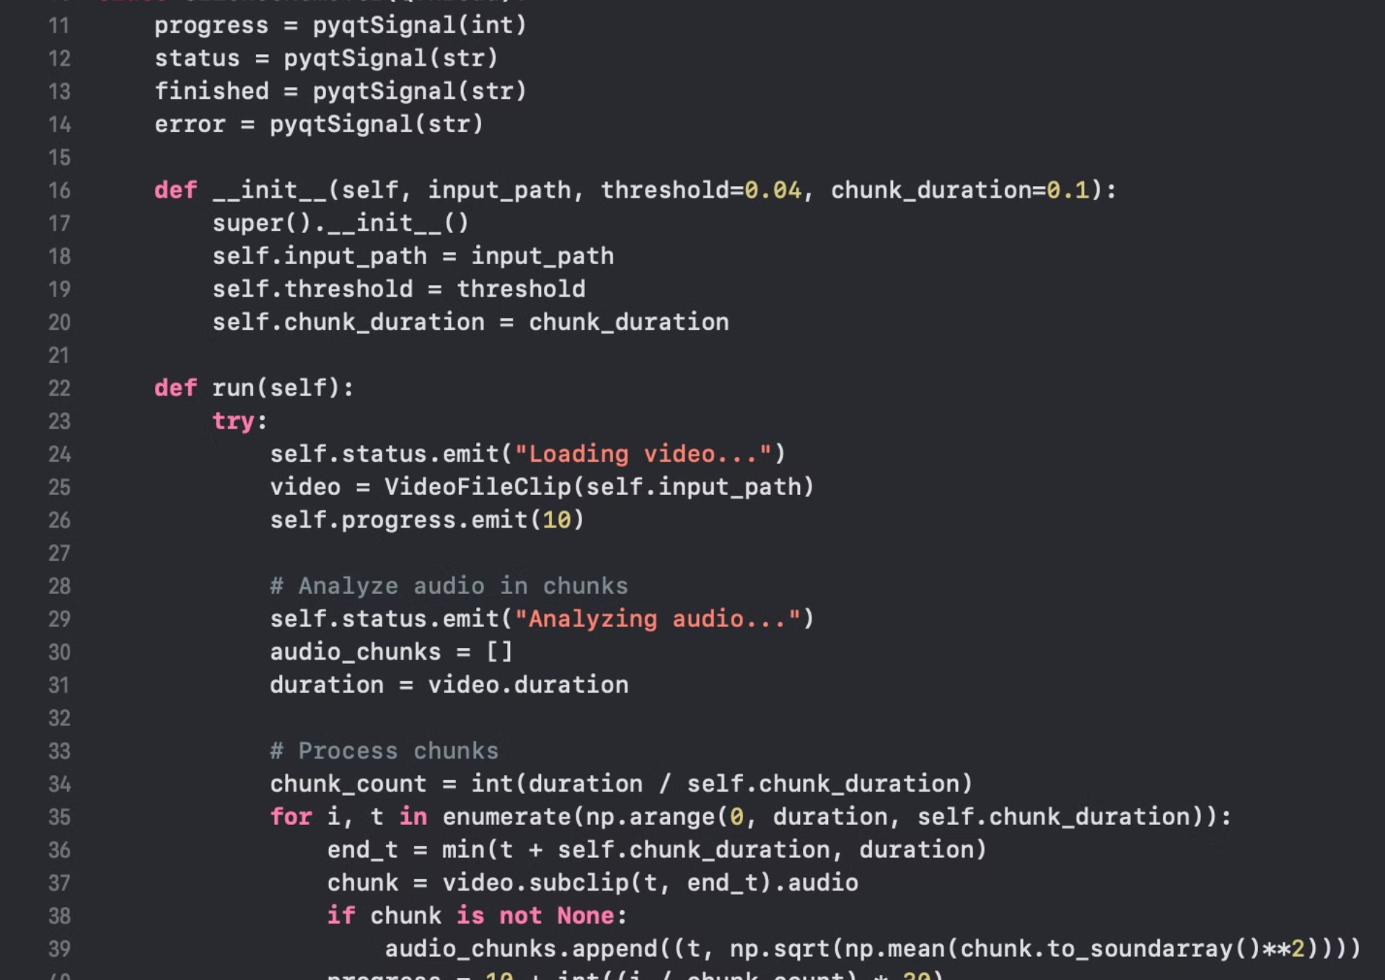
Race Against the Clock
Let's compare the efficiency of traditional video editing versus CutZero when extracting a 10 mins clip from a 1-hour video.
Traditional Editing Workflow:
Ingesting and Reviewing: Import and manually search through 1-hour footage ( 45 mins)
1
2
Trimming: Precise isolation of the 10 mins clip (10 minutes)
Exporting: Creating the final clip file (under 10 minute)
3
Total Time (Traditional): More than 1 hour
CutZero Workflow:
Automated Processing: Run video through CutZero (approximately 5 minutes)
1
2
Quick Review: Locate desired clip in condensed footage (1-2 minutes)
Final Adjustments: Fine-tuning and export (1 minute)
3
Best Case: CutZero matches traditional editing (6-8 minutes)
Typical Case: CutZero saves 2-7 minutes
Worst Case: CutZero saves up to 10 minutes
Key Factors:
Processing Speed: CutZero's efficiency depends on hardware capabilities
Detection Accuracy: Precise identification of silent/blank sections
Video Format: File type and codec affect processing time
Conclusion: Even with conservative estimates, CutZero offers significant time savings compared to traditional editing methods, especially when working with longer videos. With optimized processing speeds under 2 minutes, the efficiency gains become even more substantial.

Slide 5
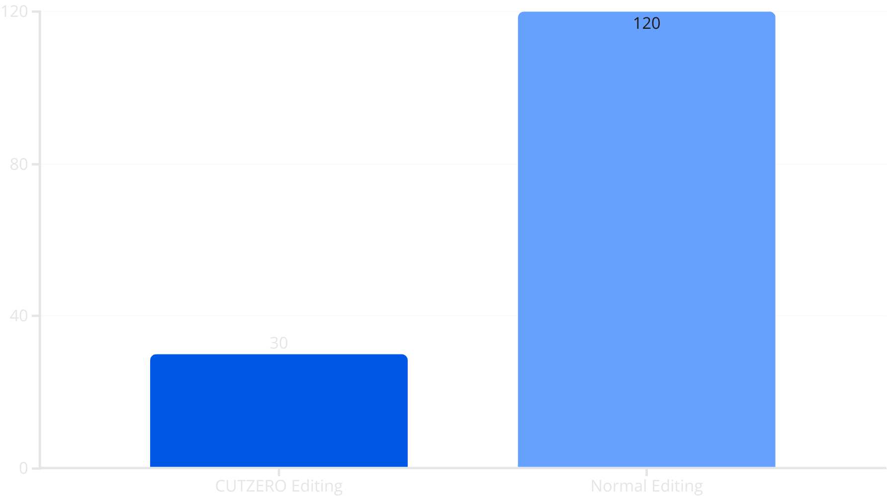
Research: The Numbers Behind Automation
Our research indicates that a significant percentage of video editors spend excessive time manually trimming silence from their videos. Automated trimming can reduce editing time by more than 50%, enabling faster project completion and increased productivity. The adoption of AI-based video editing is on the rise.

Slide 6




Methodology: The Technology Behind CutZero
Language: Python
The core language for CutZero is Python, chosen for its versatility and extensive library support. Python allows for rapid development and integration with other tools and frameworks.
Libraries: OpenCV, FFMPEG
OpenCV and FFMPEG are used for video processing and manipulation, while Pydub and MoviePy handle audio processing and video editing. Faster whisper open ai's model runs locally, PyQt5 for interfaces. Libraries provide essential functionalities . These libraries provide essential functionalities.
Process: Audio Thresholding
CutZero detects silence via audio thresholding, removing blank segments automatically while ensuring smooth transitions. This process guarantees a polished final product free of awkward pauses.

Slide 7

Challenges: Overcoming Technical Hurdles
Compatibility Issues
1
Ensuring seamless compatibility between OpenCV, FFMPEG, and Pydub posed a significant challenge. Resolving these compatibility issues required careful configuration and testing.
2
Silence Detection Accuracy
Optimizing the accuracy of silence detection was crucial to prevent unintentional removal of important audio content. Refining the audio thresholding algorithm enhanced accuracy.
Balancing Speed and Quality
3
Balancing processing speed and output quality required meticulous optimization of the video editing process. CutZero optimizes processing without sacrificing the quality.

Slide 8
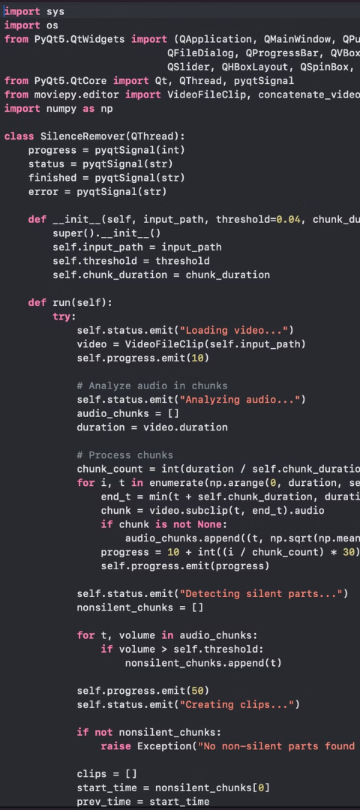


Benefits: How CutZero Enhances Your Workflow
Saves Editing Time
Enhances Engagement
CutZero significantly reduces manual trimming, saving valuable editing time. This allows content creators to focus on more creative aspects of their work, such as storytelling and visual enhancements.
By removing silent parts, CutZero ensures a smooth and engaging viewing experience, retaining audience attention. Removing unnecessary pauses ensures a tight narrative that maintains audience attention.

Slide 9

Impact: The Future of Automated Video Editing
1
Automated Video Editing
2
Time and Effort Savings
CutZero automates tedious video editing tasks, freeing up content creators to focus on more creative work. This means more time can be spent on storytelling.
The tool saves time and effort, streamlining content creation workflows and increasing productivity. This can be a huge boost to individual productivity.
3
AI-Driven Creation
CutZero contributes to the advancement of AI-driven content creation, making video editing more efficient and accessible. With future AI enhancements, the tool can evolve.

Slide 10

References: Sources and Further Reading
OpenCV, FFMPEG, Pydub, MoviePy documentation,Grok
Research papers on silence detection in videos
Market analysis on video editing trends

Slide 11

Thank You!
Thank you for your attention. We hope this presentation has provided valuable insights into CutZero and its potential to revolutionize video editing workflows. CutZero represents a significant step forward in AI-driven content creation, offering efficiency, accuracy, and ease of use. If you have any queries or would like to learn more, please feel free to reach out. We look forward to hearing from you!

